Slide 1
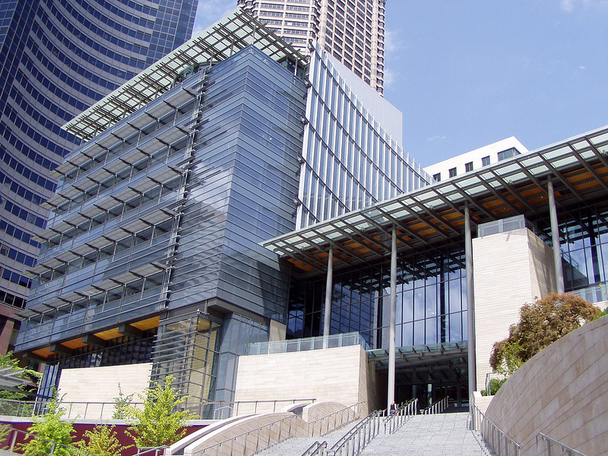
DoIT CTTAB Briefing
City of Seattle Department of Information Technology
Michael Mattmiller, Interim Chief Technology Officer July 2014

Slide 2
Agenda
New Chief Technology Officer
Vision for DoIT
Next Generation Data Center
Strategy Summary
Project mission, objectives, and success factors
Next steps
Broadband update

Slide 3
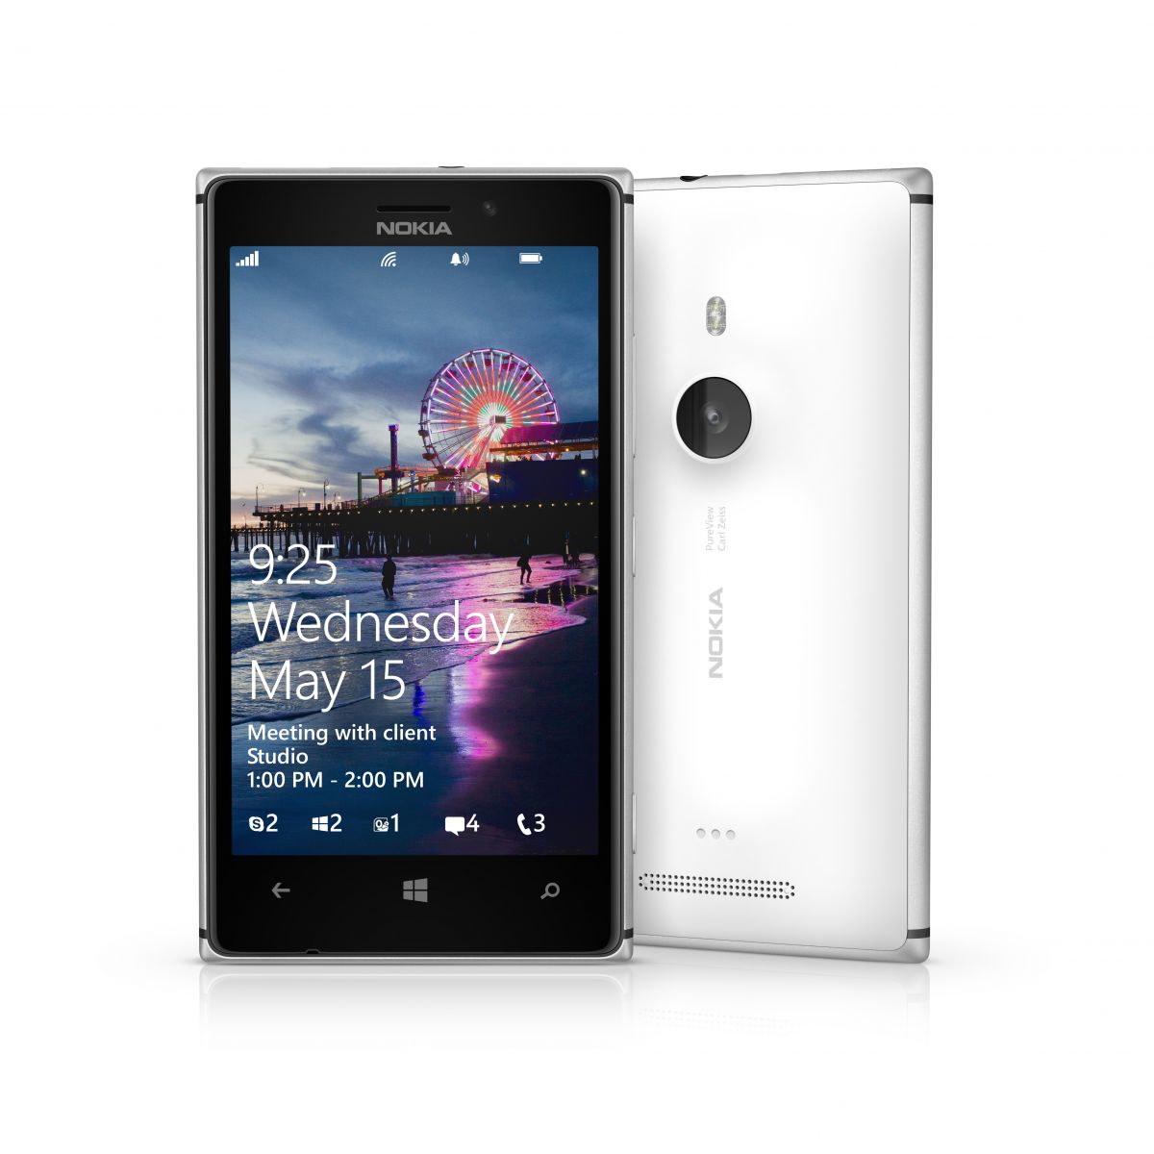
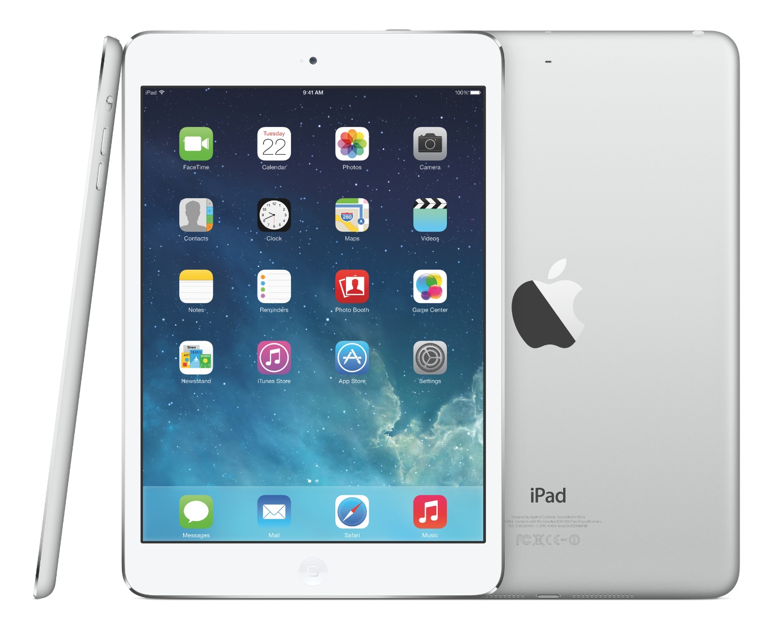
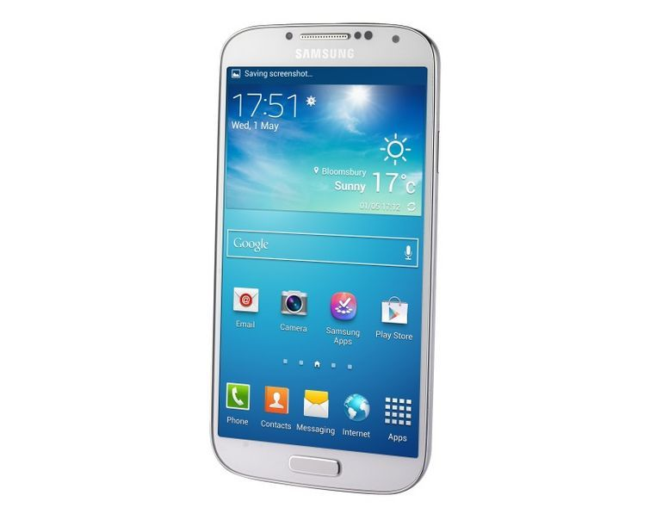
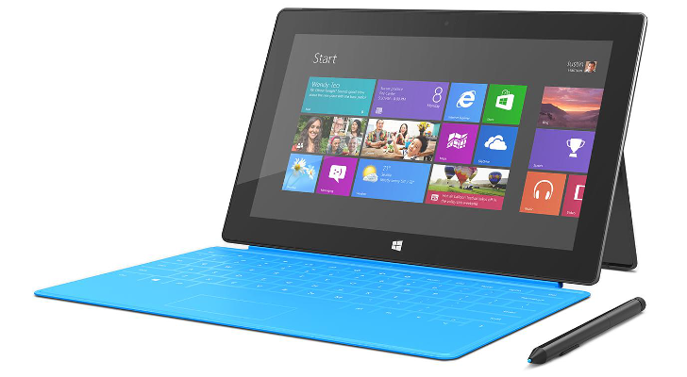
New CTO

Slide 4
New CTO
Getting started
Getting to know the team
Meeting with key stakeholders
Learning about the department
First 90 days
Organizational assessment
Filling key vacancies
Prioritizing key mayoral initiatives
Developing mission for DoIT, beginning strategic planning process

Slide 5
New CTO Vision for DoIT

Slide 6
New CTO Vision for DoIT
Serve the information needs of the public, with government information and data solutions that span the web, mobile, and television.
Focus on customer service
Evolve with technology
Empower our City workforce with innovative solutions that facilitate collaboration, efficiency, and constituent interactions.
Invest in infrastructure
Enhance governance and support
Make Seattle a national Municipal leader in championing technology access and affordability for all the people of our City.
Mayor’s Digital Equity Initiative
Broadband
Enable innovation through data sharing
Engage with partners
Deliver leading technology solutions
Investment strategy
Funding opportunities

Slide 7
Next Generation Data Center
Data Center Topology
Sourcing
Sizing
Services
Primary DC: ~3,000 - 6,000 sq ft
Current services assumption is a hybrid approach with partial shared and non-shared components.
Secondary DC: ~2,000 - 4,000 sq ft
Secondary DC: Geographically Diverse Area
Primary DC: Greater Puget Sound Area
Co-location

Slide 8
Next Generation Data Center
Mission
To manage a City-wide project to replace the City’s aging data centers and server rooms (owned and/or operated by various City departments) with a more efficient environment providing increased resiliency, maintainability, disaster recovery and business continuity while meeting compliance requirements for the City’s information technology systems by December 31, 2015.
Key Objectives
Provision of a city-wide data center environment which meets the following criteria:
Increases resiliency and service reliability.
Is agile and can adapt to changing needs and growth over time.
Addresses and mitigates significant business risks.
Meets the quality standards and services levels of the stakeholders as designed.
Key Success Factors
Key success factors for this initiative include:
The new data center facilities are functional with adequate space, power, cooling, and allow for growth.
The relocation plan has been successfully executed with minimum unplanned interruption to City operations by December 31, 2015.
Project was executed within agreed quality, scope, budget and timeline parameters.

Slide 9
Next Generation Data Center
Next steps
Design
Create business processes to support emerging needs
Use collaborative approach with decision making framework
Procure
Secure a facility that will meet the current & future needs of the City
Build & Test
Execute the design
Test process with pilot migrations
Implement
Use staged migrations to minimize disruption to City’s core business

Slide 10
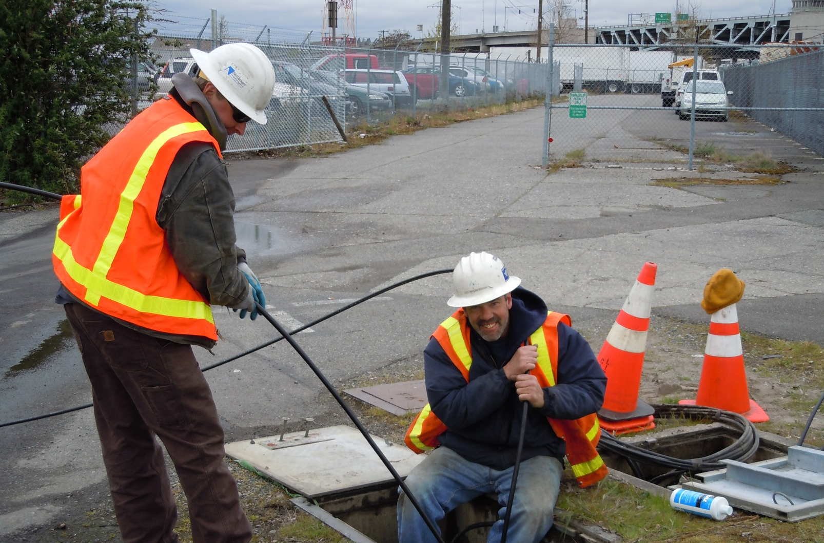
Broadband update

